Slide 1
Introduction to
Ontology-based Data Analysis
Marut Buranarach
Language and Semantic Technology Laboratory
NECTEC, Thailand
marut.bur@nectec.or.th
Tutorial Session, iSAI-NLP2017, Huahin
August 27, 2017

Slide 2
Agenda: Theory session
- Introduction to Ontology and Applications
- Roles of Ontology in Data Analysis Applications
  Domain Knowledge Modelling
  Data Integration
  Logical Reasoning
- Ontology Application Management Framework (OAM)
  Overview of OAM
  Database-to-Ontology Mapping
  Search Application Template
  Rule Management

Slide 3
Introduction to Ontology

Slide 4
Ontology
An ontology is an explicit description of a domain:
  Concepts (or Class)
  Properties
  Constraints on properties
An ontology provides a shared understanding of the domain.
  Structure of information
  Reusable domain knowledge

Slide 5
Ontology development
Classes
Properties
  Object properties (relations between classes)
  Data properties (attributes of class)
Property constraints
  Domain and Range
  Cardinality (min/ max)
Subclass-of relationships between classes
Reference: Ontology Engineering Methodology: Noy, N. F. & McGuinness, D. L. (2001), 'Ontology Development 101: A Guide to Creating Your First Ontology' , Technical report, Stanford Knowledge Systems Laboratory and Stanford Medical Informatics

Slide 6
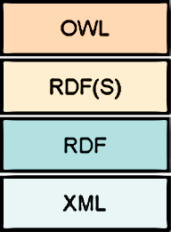
Ontology languages
OWL is the standard ontology language defined by W3C:
  OWL (Web Ontology Language)
  RDFS (RDF Schema)
  RDF (Resource Description Framework)
  XML (Extensible Markup Language)

Slide 7
Instance-of
Instances or individuals are concrete objects that are members of classes
  Each instance has unique identity.
  For example, ‘Novak Djokovic’ is an instance of ‘Tennis Player’ class.
  Usually, instances are not part of an ontology.
In RDF data model, instance-of relationship is represented using ‘rdf:type’

Slide 8
Some ontology editors
There are 41 ontology editors listed on the Wikipedia’s Ontology page
  https://en.wikipedia.org/wiki/Ontology_(information_science)#Editor
Recommended ontology editors:
  Protégé (http://protege.stanford.edu/)
  Hozo (http://www.hozo.jp/)

Slide 9
Example ontology
Bicycle
Cruiser bicycle
Touring bicycle
1
Handlebar
Utility bicycle
1
Saddle
1
Beach bicycle
Pedal
BMX bicycle
Mountain bicycle
1
Body
Is-a relation (subclass-of)
Part-of relation (property)
2
Wheel
Concept (class)

Slide 10
Ontology applications
Data integration
  Provide a global schema or unified view for integrating data from different sources.
Intelligent Applications
  Used as skeleton for constructing knowledge base that can be combined with rules in knowledge-based system.
Reusable domain knowledge
  Capture domain knowledge in a form that can be shared and reused by humans or machines.

Slide 11
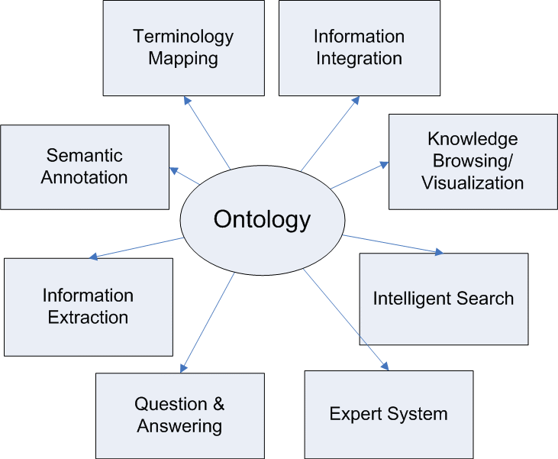
Ontology applications (2)

Slide 12
Roles of Ontology in Data Analysis Applications

Slide 13
Data Analysis
Data analysis is a process of inspecting, cleansing, transforming and modeling data with the goal of discovering useful information, suggesting conclusions, and supporting decision-making. (Wikipedia)

Slide 14
Types of data analysis
Descriptive
  describes the main aspects of the data being analyzed
Exploratory
  looking for unknown relationships
Inferential
  takes a small sample in order to point out something about a larger population
Predictive
  predicts future happenings by looking at current and past facts.
Causal
  what happens to one variable when you change some other variable

Slide 15
Data Analysis Steps
Defining data model
  structure for storing the collected data
Obtaining data from all sources and prepare the data
  data extraction, cleansing, loading
Interpreting the results
  e.g., descriptive statistics, classification, etc.
Detecting new knowledge (conclusions/ findings)
  understanding, visualization
Deploying the result and the new knowledge

Slide 16
Roles of ontology in data analysis applications
Domain Knowledge Modelling
Data Integration
Logical Reasoning

Slide 17
Domain Knowledge Modelling
Domain knowledge can be constructed from domain experts or from some discovery process.
There are 2 approaches of formulating a model of real-world
  Knowledge-driven modelling
  Data-driven modelling

Slide 18
Knowledge-driven modelling
Identify model structure
  Create appropriate model structure
The structure of the model is provided by human expert
  Using domain-specific knowledge
Theoretical approach
Ontology development is an example of the knowledge-driven approach.

Slide 19
Data-driven modelling
Determine values for the parameters
  Parameter estimation based on the observed data
Empirical approach
  “trial and errors”
Data Mining is an example of the data-driven modelling approach.
  Knowledge-driven modelling may also be used to support data-driven modelling.

Slide 20
Data Integration
Problems in integrating data from multiple data sources
  Syntactic heterogeneity
    Different data format – file formats, protocols
  Structural heterogeneity
    Different data schema – different database design
  Semantic heterogeneity
    Different in interpretation of meaning of data – semantic relationships between terms (names) and schema (tables/ columns)

Slide 21
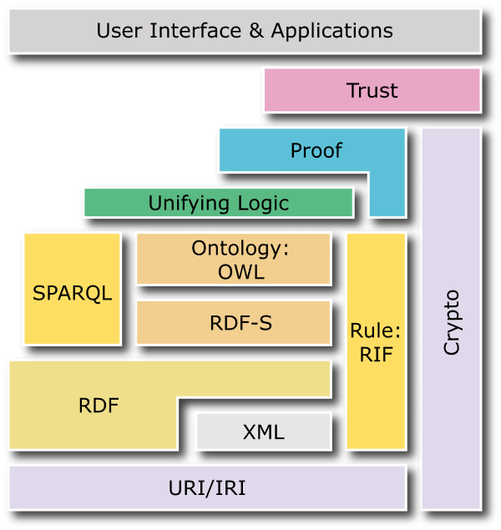
Semantic Web vs. Web
 | Semantic Web | Web
Data standards | RDF/OWL | HTML
Identifiers | URI | URL
Protocol | HTTP | HTTP
Goals | Web of data | Web of documents
Links | Linked Data | Hypertext Links

Slide 22
Ontology in Data integration
Global schema for integrating data from different sources
Adding semantics to existing labels

Slide 23
Ontology-based Data Integration
Uses ontology as a global schema for integrated data from different data sources.
  Convert data from databases to ontology-based data format (OWL + RDF format)
  Mapping database schema to ontology
RDF (Resource Description Framework) and OWL (Web Ontology Language) standards are designed for semantic-based data integration
  Linked Data

Slide 24
Ontology-based Data Integration (2)
Uses ontology to add semantics to existing labels
  Data annotation using concepts/ properties in ontology
Integrate domain knowledge with raw data
  ‘semantic enrichment’
Examples:
  Extract terms from Web pages and annotated them with ontology terms.
  e.g. <university>Thammasat University</university> (‘university’ is defined as a subclass of ‘educational institute’ in ontology)

Slide 25
Database to Ontology Mapping
Generates mappings from relational database to RDF data format by incorporating domain ontology.
Users need to create customized mapping rules.
The resulted RDF data from different data sources can have the same schema defined in the domain ontology.

Slide 26
RDB to RDF mapping languages
D2RQ Mapping Language
  a declarative language to describe mappings between relational database schemata and OWL/RDFS ontologies developed by the University of Berlin
  D2RQ Platform (http://d2rq.org/)
R2RML: RDB to RDF Mapping Language
  http://www.w3.org/TR/r2rml/
  W3C Recommendation (September 2012)

Slide 27
D2RQ Mapping Language
# Namespaces are omitted for brevity
# Specify Database connection
map:Database1 a d2rq:Database;
d2rq:jdbcDSN "jdbc:mysql://localhost/test_db";
d2rq:jdbcDriver "com.mysql.jdbc.Driver";
d2rq:username "user";
d2rq:password "password"; .
# --- generating instances of a class with records in a table --------------------
map:Conference a d2rq:ClassMap;
d2rq:dataStorage map:Database1;
d2rq:class :Conference;
d2rq:uriPattern "http://conferences.org/comp/confno@@Conferences.ConfID@@"; .
# --- generating property values for instances --------------------
map:eventTitle a d2rq:PropertyBridge;
d2rq:belongsToClassMap map:ExampleClass;
d2rq:property :eventTitle;
d2rq:column “Conferences.Name";
d2rq:datatype xsd:string; .
Class name
PK of the table
Property name
Column name of the table
Reference: http://d2rq.org/d2rq-language
Sample output
<http://conferences.org/comp/confno7369> rdf:type :Conference.
< http://conferences.org/comp/confno7369> :eventTitle “iSAI-NLP".

Slide 28
R2RML Mapping Language
@prefix rr: <http://www.w3.org/ns/r2rml#>.
@prefix ex: <http://example.com/ns#>.
<#TriplesMap1>
rr:logicalTable [ rr:tableName "EMP" ];
rr:subjectMap [
rr:template "http://data.example.com/employee/{EMPNO}";
rr:class ex:Employee;
];
rr:predicateObjectMap [
rr:predicate ex:name;
rr:objectMap [ rr:column "ENAME" ];
].
Table name
PK of the table
Class name
Property name
Column name of the table
Reference: https://www.w3.org/TR/r2rml/
Sample output
<http://data.example.com/employee/7369> rdf:type ex:Employee.
<http://data.example.com/employee/7369> ex:name "SMITH".

Slide 29
Logical reasoning with ontology-based data
Logical reasoning can be applied with ontology-based data (knowledge base) when a program must conclude some information that has not been explicitly told about.
Inference is the process of creating some new information in the knowledge base from what it already knows.

Slide 30
Applications of logical reasoning in data analysis
Can be used to support pre-processing of the data or post-processing of the resulted model in data analysis.
Consistency checking
  Constraints defined to detect inconsistency in the collected data and results
  For example, if the data shows a person with pregnant property as true, it may be inferred that the person’s gender is female.
    e.g., pregnant (?x) -> female(?x)

Slide 31
Applications of logical reasoning in data analysis (2)
Allow deriving new information from metadata
Infer new knowledge from the annotated items
  e.g., infer user’s interested topics based on the topic of the news article that the user read.
    watchNews (?x,?y) ^ hasTopic (?y,?z) -> hasInterestedTopic (?x,?z)
    If the user is reading a news article in the sport topic, it may be inferred that his interest is in the sport topic.

Slide 32
Applications of logical reasoning in data analysis (3)
Automatic interpretation of the collected data
Infer new knowledge from the knowledge base,
e.g., infer categories of sky objects from the collected data
  If the object is very big, has bright light, not moving, it may be interred as a star.
    isVeryBig (?x) ^ hasLight (?x) ^ twinkle (?x) ^ fixedPoint (?x) -> Star (?x)
  If the object is small, has no light, moving, it may be interred as a planet.
    isSmall (?x) ^ noLight (?x) ^ notTwinkle (?x) ^ revolve (?x) -> Planet (?x)

Slide 33
Inference over RDF Data
RDF/ RDFS Inference
OWL/ DL Inference
Rule-based Inference

Slide 34
RDF(S) Inference
RDF 1.1 Semantics
  W3C Recommendation 25 February 2014
  https://www.w3.org/TR/2014/REC-rdf11-mt-20140225/
Include defined entailment rules for:
  Subclass-of
  Subproperty-of
  Domain
  Range

Slide 35
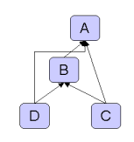
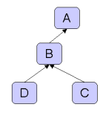
RDF(S) Inference: Example
Asserted relationships
Inferred relationships
Subclass-of
Source: https://jena.apache.org/documentation/inference/

Slide 36
OWL/DL Inference
OWL Inference is largely based on Description Logics (DL)
DL is a family of logic that is fragment of First-order Logic (FOL)
  Lower expressiveness than FOL
  Lower computational complexity than FOL
OWL 2 Web Ontology Language
RDF-Based Semantics (Second Edition)
  W3C Recommendation 11 December 2012
  https://www.w3.org/TR/owl2-rdf-based-semantics/

Slide 37
OWL/ DL Inference
Include entailment rules for:
  owl:intersectionOf
  owl:unionOf
  owl:equivalentClass
  owl:disjointWith
  owl:sameAs, owl:differentFrom, owl:distinctMembers
  owl:equivalentProperty, owl:inverseOf
  owl:FunctionalProperty, owl:InverseFunctionalProperty
  owl:SymmeticProperty, owl:TransitiveProperty
  owl:someValuesFrom
  owl:allValuesFrom
  owl:minCardinality, owl:maxCardinality, owl:cardinality
  owl:hasValue

Slide 38
Rules and Rule-based Inference
Rules are representations of knowledge with conditions in some domains of logic, such as First-order logic (FOL).
A rule is basically defined in form of If-then clauses containing logical functions and operations, and can be expressed in rule languages.

Slide 39
Rule language
The rule language can enhance the ontology language by allowing one to describe relations that cannot be described using DL used in OWL.
An example of rule in FOL:
  hasParent(?x, ?y) ^ hasBrother(?y, ?z) → hasUncle(?x, ?z)

Slide 40
Some rule languages
FOL-RuleML (First-order Logic Rule Markup Language)
SWRL (Semantic Web Rule Language)
Notation3
Jena rules
RIF (Rule Interchange Format)

Slide 41
Examples of rule syntax
SWRL | <ruleml:imp xml:base=”#”> <ruleml:_body> <swrlx:individualPropertyAtom swrlx:property="hasParent"> <ruleml:var>a</ruleml:var> <ruleml:var>b</ruleml:var> </swrlx:individualPropertyAtom> <swrlx:individualPropertyAtom swrlx:property="hasBrother"> <ruleml:var>b</ruleml:var> <ruleml:var>c</ruleml:var> </swrlx:individualPropertyAtom> </ruleml:_body> <ruleml:_head> <swrlx:individualPropertyAtom swrlx:property="hasUncle"> <ruleml:var>a</ruleml:var> <ruleml:var>c</ruleml:var> </swrlx:individualPropertyAtom> </ruleml:_head> </ruleml:imp>
Jena Rule | @prefix : <#>. [ RulehasUncle: ( ?a :hasFather ?b ) ( ?b :hasBrother ?c ) -> ( ?a :hasUncle ?c ) ]
RIF | Document (Prefix( <#>) Group (ForAll ?a ?b ?c And( :hasFather(?a ?b) :hasBrother(?b ?c) ) :- :hasUncle(?a ?c)))
Source: Rattanasawad, T., SaiKeaw, K., Buranarach, M., and Supnithi, T., A Review and Comparison of Rule Languages and Rule-based Inference Engines for the Semantic Web, Proc. of ICSEC2013 - Workshop on Ontology and Semantic Web for Big Data, Sep 2013

Slide 42
Some rule-based inference engines
Jena inference engine
EYE (Euler YAP Engine)
OWLIM
BaseVISor
Source: Rattanasawad, T., SaiKeaw, K., Buranarach, M., and Supnithi, T., A Review and Comparison of Rule Languages and Rule-based Inference Engines for the Semantic Web, Proc. of ICSEC2013 - Workshop on Ontology and Semantic Web for Big Data, Sep 2013

Slide 43
RDF data querying using SPARQL
Ontology-based data in RDF can be queried using SPARQL.
SPARQL is based on matching triple patterns against RDF triples.
Triple pattern is similar to RDF triple but can contain variables.
Example:
  <http://a.org/person1> <http://a.org/has_name> ?name .
variable

Slide 44
Example of SPARQL Query
RDF Data:
  <http://a.org/person1> <http://a.org/has_name> “John Smith”.
Query:
SELECT ?name
WHERE {<http://a.org/person1> <http://a.org/has_name> ?name .
}
Result:
?name
John Smith

Slide 45
Summary
Ontology is:
  Shared and reusable domain knowledge
  Usually relied on domain experts
Roles of ontology in data analysis applications
  Model domain knowledge
  Support integrating heterogeneous sources of data
  Apply logical reasoning for some data analysis steps
Database to ontology mapping is required for converting database to ontology-based data (RDF)
  Reasoning can be applied based on RDF, ontology and/or rule-based inference.
  RDF data can be queried using SPARQL.

Slide 46
Ontology Application Management Framework (OAM) Framework
http://lst.nectec.or.th/oam/
Buranarach, M., Supnithi, T., Thein, Y.M., Ruangrajitpakorn, T., Rattanasawad, T., Wongpatikaseree, K., Lim, A. O., Tan Y., and Assawamakin, A., OAM: An Ontology Application Management Framework for Simplifying Ontology-based Semantic Web Application Development, International Journal of Software Engineering and Knowledge Engineering (IJSEKE), Vol. 26, No. 1, Feb 2016, 115-145.

Slide 47
Motivations
High learning curve and efforts demanded in building ontology-based applications.
Most development tools are designed for programmers, not for domain experts.
Simplifying development of ontology –based applications is important in promoting adoption of the Semantic Web technologies.

Slide 48
Benefits of OAM Framework
Providing reusable and configurable application templates.
  No programming skill is required.
  Domain experts can build their own application prototypes.
Application template is ideal for rapid prototyping and hypotheses testing.
The framework provides Web API to support a more advanced application development.

Slide 49
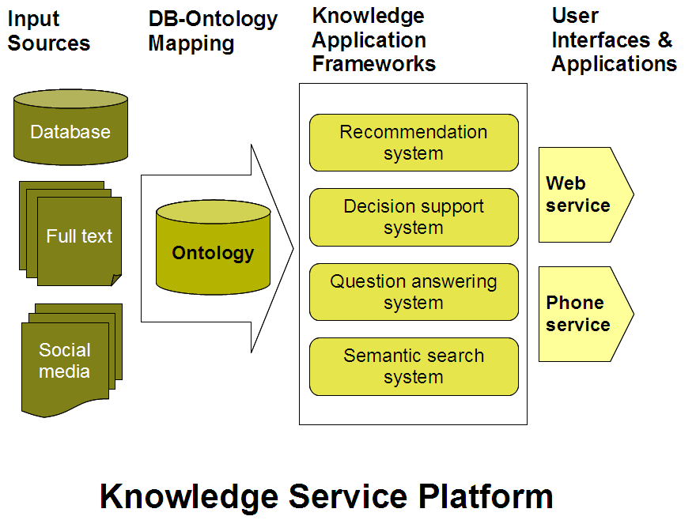
Ontology-based Applications

Slide 50
Specifications
Supports RDF data publishing from databases
Supports building knowledge-based systems
  Currently focus on Search, Recommender and Decision Support System Applications.
Supported DBMS
  MySQL
Supported Ontology Editor
  Hozo (http://www.hozo.jp/)
  Protégé (http://protege.stanford.edu/) – with no OWL/DL inference support

Slide 51
Specifications (2)
OAM Framework was developed using:
  Apache Jena (http://jena.apache.org/)
  Triplestore: Jena’s TDB (Virtuoso support is under development)
  RDB2RDF Mapping: D2RQ (http://d2rq.org/)
  Reasoner: Jena’s Inference Engine (https://jena.apache.org/documentation/inference/)
    RDF(S) inference support
    Rule-based inference support

Slide 52
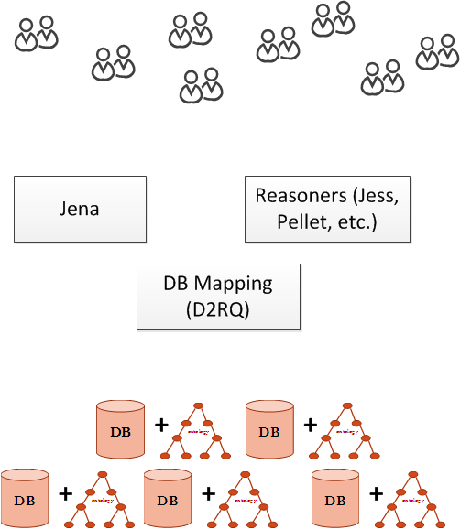
Ontology-based application development

Slide 53
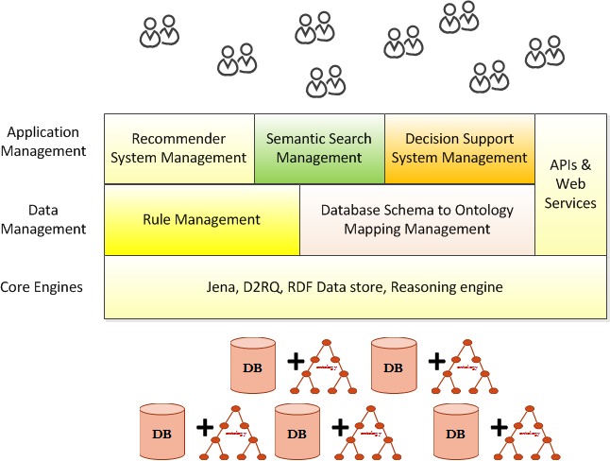






Architecture of Ontology Application Management (OAM) Framework

Slide 54
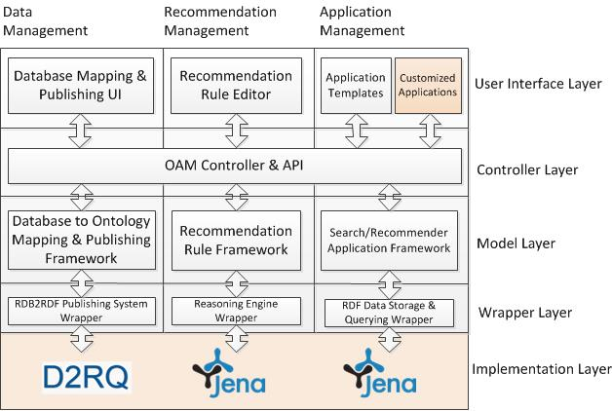
OAM Architecture

Slide 55
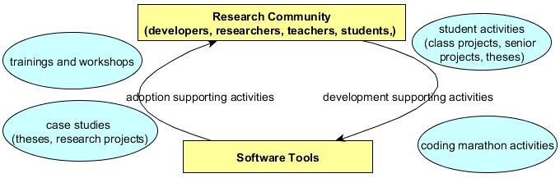
Community-driven Software Development
Buranarach, M., Thein, Y. M., and Supnithi, T., A Community-driven Approach to Development of an Ontology-based Application Management Framework, Proc. of the 2nd Joint International Semantic Technology Conference (JIST2012), LNCS, Springer, December 2012.

Slide 56
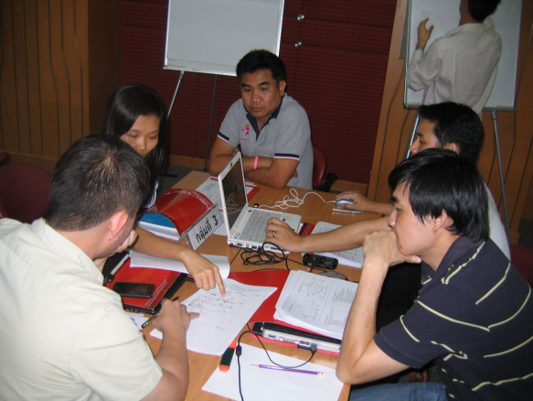
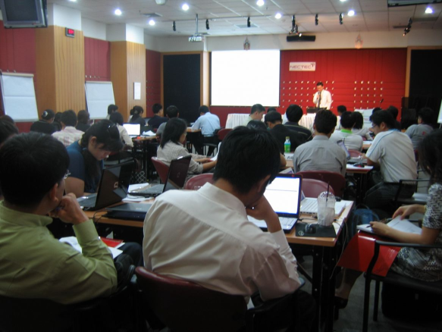
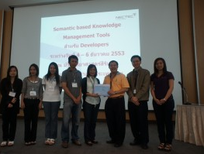
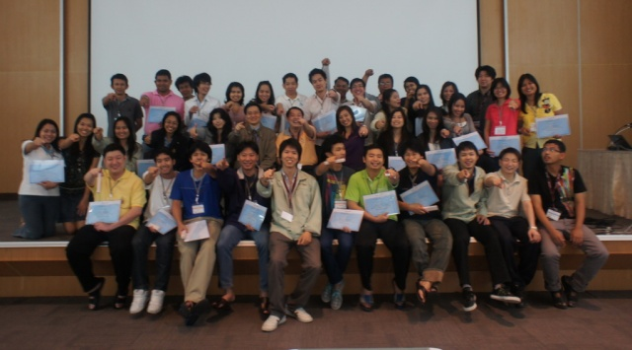
Support Activities
User trainings
Hozo
OAM
Developer’s coding marathon

Slide 57
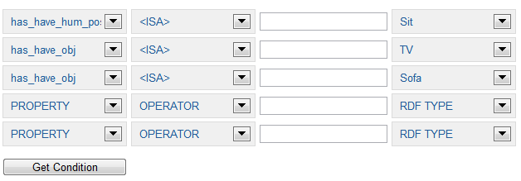
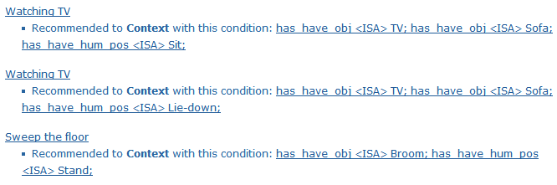

Case Study: Activity Recognition in Smart Home
Ontology-Database Mapping
Recommendation Rule Management
Semantic Search Application Template
Wongpatikaseree, K., Ikeda, M., Buranarach, M., Supnithi, T., Lim, A. O., and Tan Y., Activity Recognition using Context-Aware Infrastructure Ontology in Smart Home Domain, Proc. of the 7th International Conference on Knowledge, Information and Creativity Support Systems (KICSS2012), November 2012.

Slide 58
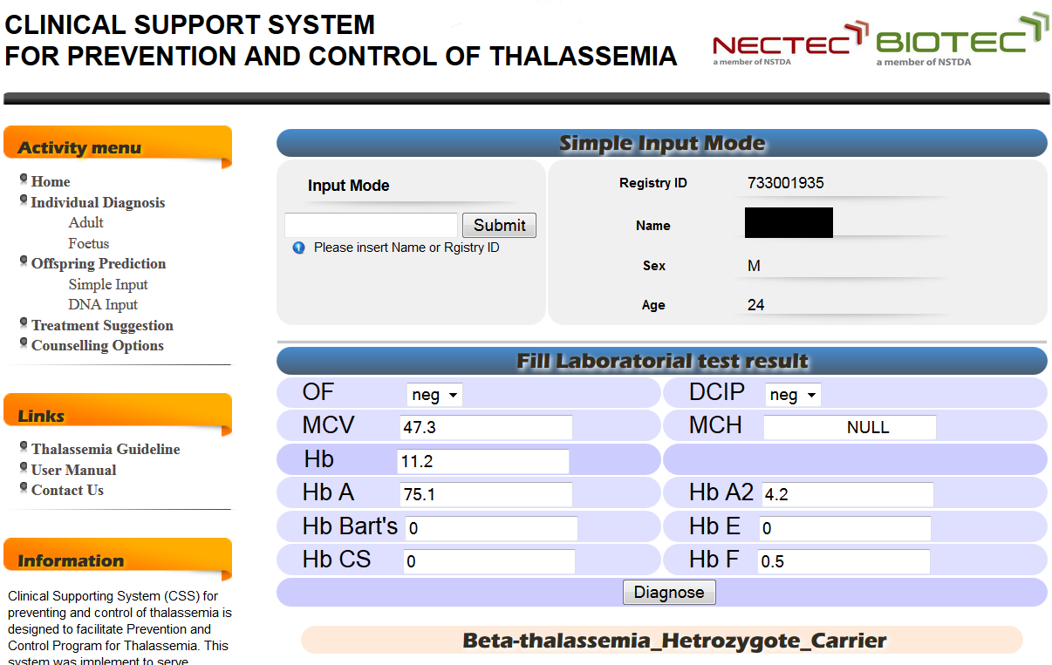


Case Study: Clinical Support System for Thallasemia

Slide 59
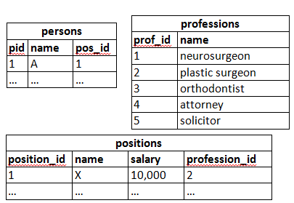
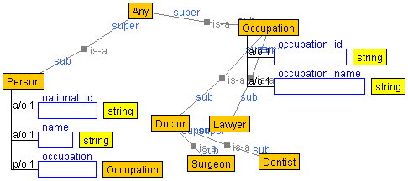
Database-to-Ontology Mapping
Database tables
Ontology for the KB

Slide 60
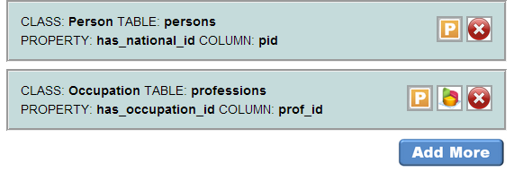
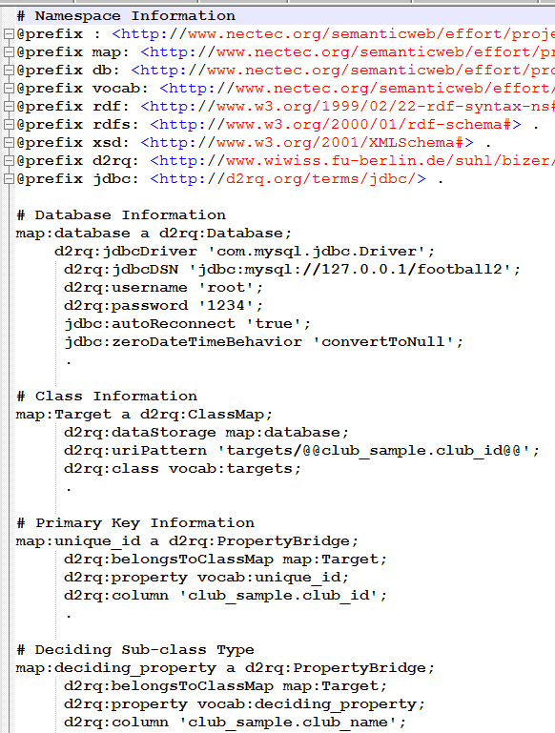
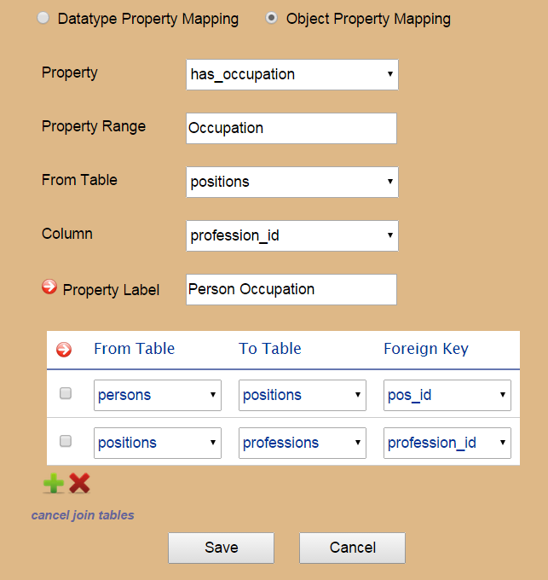
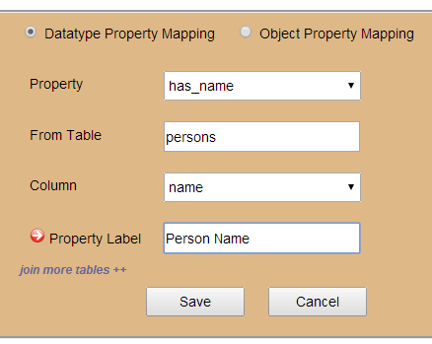
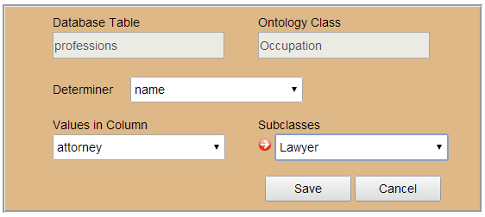
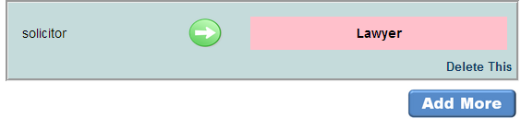
Database-to-Ontology Mapping (2)
Resulted D2RQ Mapping language
Class-table mapping
Data property to column mapping
Object property to column
mapping
Subclass mapping

Slide 61
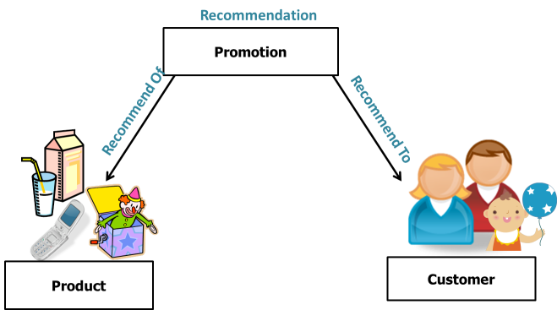


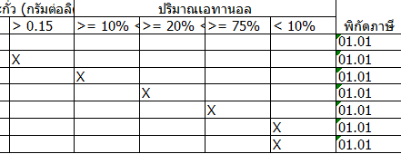
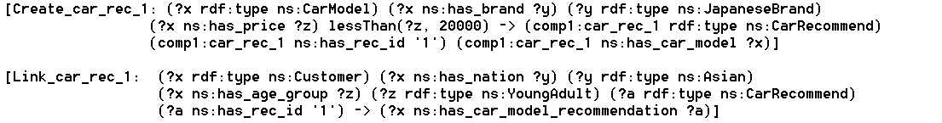
Rule Management
“Honda Jazz”
“Honda City”
“Toyota Vios”
“Nissan March”
“Suzuki Swift”
“Nobita”
“Kim”
“Somchai”
Recommendation Results
Decision table in spreadsheet
IS-A CarModel
brand IS-A JapaneseBrand price < “600000”
IS-A Customer
nation IS-A Asian and age IS-A YoungAdult
Jena’s Rule Syntax

Slide 62
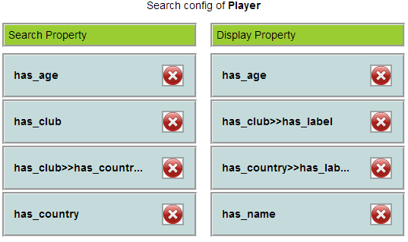
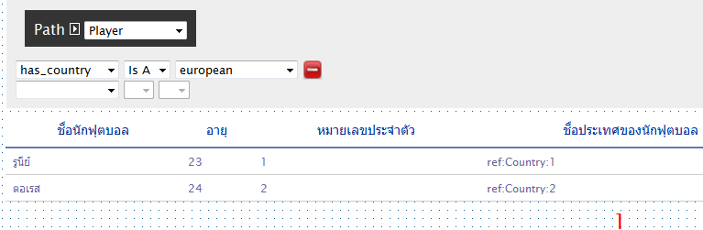
Search Application Template
application configuration
application template

Slide 63
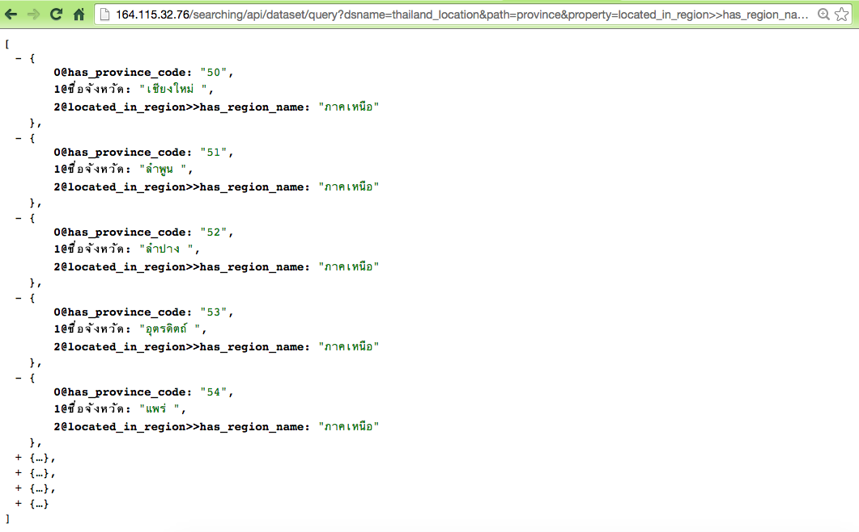
Web API for Querying
URL: http://<hostname>/searching/api/dataset/query?
path=province&property=located_in_region>>has_region_name&
operator=CONTAINS&value=aaa
URL request specifies:
Class name
Property name
Operator
Property value
JSON Results

