Slide 1
Introduction to Ontology-based Application Development using OAM Framework
Marut Buranarach
Language and Semantic Technology Laboratory
NECTEC, Thailand
marut.bur@nectec.or.th
Tutorial Session, JIST2016, Singapore
November 2, 2016

Slide 2
Agenda: Theory session
Introduction to Ontology-based Application Development
  Overview of Ontology and Ontology Development
  Relational Database to RDF Mapping
  Reasoning for the Knowledge Base
  Knowledge Base Querying using SPARQL
Ontology Application Management Framework (OAM)
  Overview of OAM
  Database-to-Ontology Mapping
  Search Application Template
  Rule Management

Slide 3
Introduction to Ontology-based Application Development

Slide 4
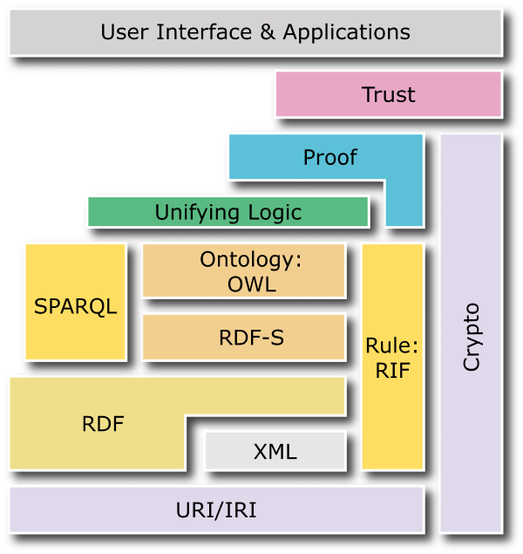
W3C Semantic Web Stack

Slide 5
The Semantic Web
The Semantic Web is an W3C initiative to provide the data standards for data integration over the Web.
  Machine-readable and understandable data
  Structured and Linked data
  Uses global identifiers, i.e. URI, to refer to things
Resource Description Framework (RDF) is the core standard of the Semantic Web standards.

Slide 6
Ontology and the Semantic Web
Ontology adds semantics to the RDF Data.
Some basic ontology constructs are:
  Subclass-of
  Object property, Data Property
  Subproperty-of
  Domain, Range
  etc.

Slide 7
RDF and Ontology
Source: Dieter Fensel and Federico Facca, Semantic Web course lecture at STI: http://www.sti-innsbruck.at/teaching/curriculum/semantic-web

Slide 8
Ontology applications
Data integration
  Provide a global schema or unified view for integrating data from different sources.
Intelligent Applications
  Used as skeleton for constructing knowledge base that can be combined with rules in knowledge-based system.
Reusable domain knowledge
  Capture domain knowledge in a form that can be shared and reused by humans or machines.

Slide 9
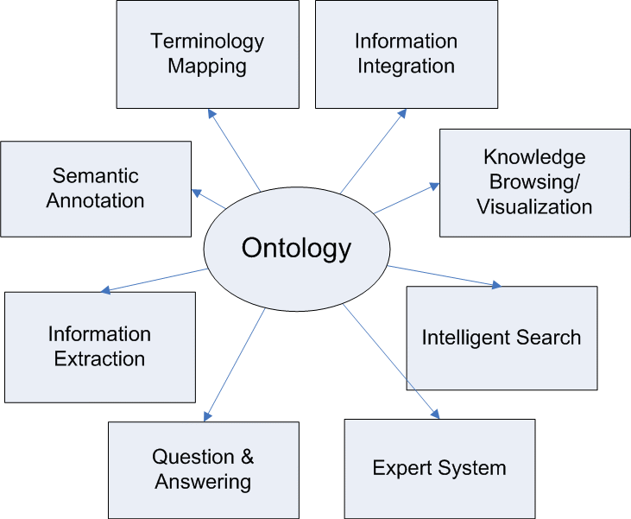
Ontology applications (2)

Slide 10
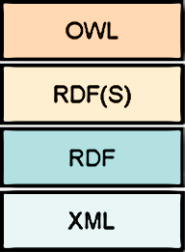
Ontology languages
OWL is the standard ontology language defined by W3C:
  OWL (Web Ontology Language)
  RDFS (RDF Schema)
  RDF (Resource Description Framework)
  XML (Extensible Markup Language)

Slide 11
Ontology development
Classes
Properties
  Object properties
  Data properties
Property constraints
  Domain and Range
  Cardinality (min/ max)
Subclass-of relationships between classes
Reference: Ontology Engineering Methodology: Noy, N. F. & McGuinness, D. L. (2001), 'Ontology Development 101: A Guide to Creating Your First Ontology' , Technical report, Stanford Knowledge Systems Laboratory and Stanford Medical Informatics

Slide 12
Some ontology editors
There are 41 ontology editors listed on the Wikipedia’s Ontology page
  https://en.wikipedia.org/wiki/Ontology_(information_science)#Editor
In this tutorial, I’ll only focus on two ontology editors:
  Protégé (http://protege.stanford.edu/)
  Hozo (http://www.hozo.jp/)

Slide 13
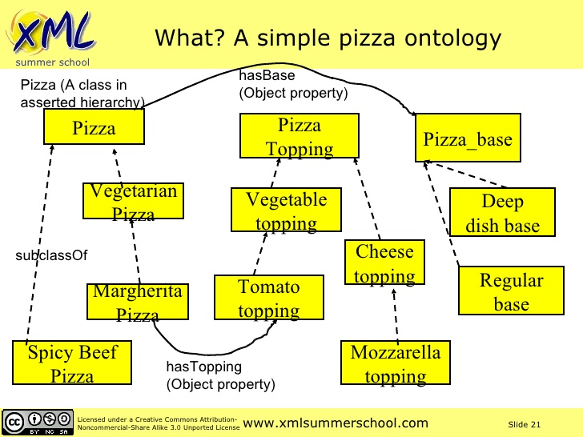
Example ontology

Slide 14
Ontology vs. Knowledge Base
An ontology typically describes a vocabulary for communicating about a domain.
  Conceptual structures of a domain
  State-independent information (Guarino, 1998)
A knowledge-base contains the knowledge needed to solve problems or answer queries about such a domain by committing to an ontology
  Concrete state of the domain
  State-dependent information (Guarino, 1998)
N. Guarino, Formal Ontology and Information Systems. Proceedings of FOIS’98, 1998

Slide 15
Instance-of
Instances or individuals are concrete objects that are members of classes
  Each instance has unique identity.
  For example, ‘Novak Djokovic’ is an instance of ‘Tennis Player’ class.
  Usually, instances are not part of an ontology.
In RDF data model, instance-of relationship is represented using ‘rdf:type’

Slide 16
Creating Instances
There are typically two methods in creating instances for ontology classes in building a knowledge base.
  Manually construct an instance based on a class using instance editor provided in ontology editor.
  Create instances from some existing information sources, such as database records.
The second approach is most suitable when an organization already stored the data in some databases.

Slide 17
Creating instances from database
Creating instances from database typically requires the mapping process between the existing database schema and ontology structure.
After the mapping process, database records can be properly transformed into class instances, i.e. RDF data.

Slide 18
Relational database to RDF Mapping
There are two approaches for RDB-to-RDF Mapping:
  Automatic mapping generation (Local ontology mapping)
    e.g., Virtuoso RDF View, D2RQ, SquirrelRDF
  Domain semantics‐driven mapping generation (Domain ontology mapping)
    e.g., D2RQ
Sahoo, S.S., Halb, W., Hellmann, S., Idehen, K., Thibodeau, T., Auer, S., Sequeda, J., Ezzat, A.: A Survey of Current Approaches for Mapping of Relational Databases to RDF. W3C RDB2RDF Incubator Group (2009).

Slide 19
Automatic mapping generation
Map an RDB table as a RDF class, an RDB column as an RDF property, an RDB record as an instance
RDB schema is used as the schema for the generated RDF data
Advantage – simple, easy to do
Disadvantage – can not capture complex domain semantics that are required by many applications

Slide 20
Domain semantics‐driven mapping generation
Generates mappings from RDB to RDF by incorporating domain ontology.
Users need to create customized mapping rules.
Advantage: the resulted RDF data from different data sources can have the same schema defined in the domain ontology.
Disadvantage: require creation of mapping rules

Slide 21
RDB to RDF mapping languages
D2RQ Mapping Language
  a declarative language to describe mappings between relational database schemata and OWL/RDFS ontologies developed by the University of Berlin
  D2RQ Platform (http://d2rq.org/)
R2RML: RDB to RDF Mapping Language
  http://www.w3.org/TR/r2rml/
  W3C Recommendation (September 2012)

Slide 22
D2RQ Mapping Language
# Namespaces are omitted for brevity
# Specify Database connection
map:Database1 a d2rq:Database;
d2rq:jdbcDSN "jdbc:mysql://localhost/test_db";
d2rq:jdbcDriver "com.mysql.jdbc.Driver";
d2rq:username "user";
d2rq:password "password"; .
# --- generating instances of a class with records in a table --------------------
map:Conference a d2rq:ClassMap;
d2rq:dataStorage map:Database1;
d2rq:class :Conference;
d2rq:uriPattern "http://conferences.org/comp/confno@@Conferences.ConfID@@"; .
# --- generating property values for instances --------------------
map:eventTitle a d2rq:PropertyBridge;
d2rq:belongsToClassMap map:ExampleClass;
d2rq:property :eventTitle;
d2rq:column “Conferences.Name";
d2rq:datatype xsd:string; .
Class name
PK of the table
Property name
Column name of the table
Reference: http://d2rq.org/d2rq-language
Sample output
<http://conferences.org/comp/confno7369> rdf:type :Conference.
< http://conferences.org/comp/confno7369> :eventTitle “JIST".

Slide 23
R2RML Mapping Language
@prefix rr: <http://www.w3.org/ns/r2rml#>.
@prefix ex: <http://example.com/ns#>.
<#TriplesMap1>
rr:logicalTable [ rr:tableName "EMP" ];
rr:subjectMap [
rr:template "http://data.example.com/employee/{EMPNO}";
rr:class ex:Employee;
];
rr:predicateObjectMap [
rr:predicate ex:name;
rr:objectMap [ rr:column "ENAME" ];
].
Table name
PK of the table
Class name
Property name
Column name of the table
Reference: https://www.w3.org/TR/r2rml/
Sample output
<http://data.example.com/employee/7369> rdf:type ex:Employee.
<http://data.example.com/employee/7369> ex:name "SMITH".

Slide 24
Reasoning in Knowledge Bases
Reasoning is required in knowledge base when a program must conclude some information that has not been explicitly told about.
Inference is the process of creating some new information in the knowledge base from what it already knows.
In RDF, inference is called entailment.

Slide 25
Inference over RDF Data
RDF/ RDFS Inference
OWL/ DL Inference
Rule-based Inference

Slide 26
RDF(S) Inference
RDF 1.1 Semantics
  W3C Recommendation 25 February 2014
  https://www.w3.org/TR/2014/REC-rdf11-mt-20140225/
Include defined entailment rules for:
  Subclass-of
  Subproperty-of
  Domain
  Range

Slide 27
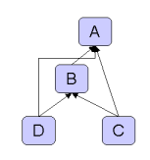
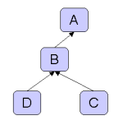
RDF(S) Inference: Example
Asserted relationships
Inferred relationships
Subclass-of
Source: https://jena.apache.org/documentation/inference/

Slide 28
RDF(S) Entailment
Source: Dieter Fensel and Federico Facca, Semantic Web course lecture at STI: http://www.sti-innsbruck.at/teaching/curriculum/semantic-web

Slide 29
RDF(S) Entailment
Source: Dieter Fensel and Federico Facca, Semantic Web course lecture at STI: http://www.sti-innsbruck.at/teaching/curriculum/semantic-web

Slide 30
RDF(S) Entailment
Source: Dieter Fensel and Federico Facca, Semantic Web course lecture at STI: http://www.sti-innsbruck.at/teaching/curriculum/semantic-web

Slide 31
OWL/DL Inference
OWL Inference is largely based on Description Logics (DL)
DL is a family of logic that is fragment of First-order Logic (FOL)
  Lower expressiveness than FOL
  Lower computational complexity than FOL
OWL 2 Web Ontology Language
RDF-Based Semantics (Second Edition)
  W3C Recommendation 11 December 2012
  https://www.w3.org/TR/owl2-rdf-based-semantics/

Slide 32
OWL/ DL Inference
Include entailment rules for:
  owl:intersectionOf
  owl:unionOf
  owl:equivalentClass
  owl:disjointWith
  owl:sameAs, owl:differentFrom, owl:distinctMembers
  owl:equivalentProperty, owl:inverseOf
  owl:FunctionalProperty, owl:InverseFunctionalProperty
  owl:SymmeticProperty, owl:TransitiveProperty
  owl:someValuesFrom
  owl:allValuesFrom
  owl:minCardinality, owl:maxCardinality, owl:cardinality
  owl:hasValue

Slide 33
Rules and Rule-based Inference
Rules are representations of knowledge with conditions in some domains of logic, such as First-order logic (FOL).
A rule is basically defined in form of If-then clauses containing logical functions and operations, and can be expressed in rule languages.

Slide 34
Rule language
The rule language can enhance the ontology language by allowing one to describe relations that cannot be described using DL used in OWL.
An example of rule in FOL:
  hasParent(?x, ?y) ^ hasBrother(?y, ?z) → hasUncle(?x, ?z)

Slide 35
Some rule languages
FOL-RuleML (First-order Logic Rule Markup Language)
SWRL (Semantic Web Rule Language)
Notation3
Jena rules
RIF (Rule Interchange Format)

Slide 36
Examples of rule syntax
SWRL | <ruleml:imp xml:base=”#”> <ruleml:_body> <swrlx:individualPropertyAtom swrlx:property="hasParent"> <ruleml:var>a</ruleml:var> <ruleml:var>b</ruleml:var> </swrlx:individualPropertyAtom> <swrlx:individualPropertyAtom swrlx:property="hasBrother"> <ruleml:var>b</ruleml:var> <ruleml:var>c</ruleml:var> </swrlx:individualPropertyAtom> </ruleml:_body> <ruleml:_head> <swrlx:individualPropertyAtom swrlx:property="hasUncle"> <ruleml:var>a</ruleml:var> <ruleml:var>c</ruleml:var> </swrlx:individualPropertyAtom> </ruleml:_head> </ruleml:imp>
Jena Rule | @prefix : <#>. [ RulehasUncle: ( ?a :hasFather ?b ) ( ?b :hasBrother ?c ) -> ( ?a :hasUncle ?c ) ]
RIF | Document (Prefix( <#>) Group (ForAll ?a ?b ?c And( :hasFather(?a ?b) :hasBrother(?b ?c) ) :- :hasUncle(?a ?c)))
Source: Rattanasawad, T., SaiKeaw, K., Buranarach, M., and Supnithi, T., A Review and Comparison of Rule Languages and Rule-based Inference Engines for the Semantic Web, Proc. of ICSEC2013 - Workshop on Ontology and Semantic Web for Big Data, Sep 2013

Slide 37
Some rule-based inference engines
Jena inference engine
EYE (Euler YAP Engine)
OWLIM
BaseVISor
Source: Rattanasawad, T., SaiKeaw, K., Buranarach, M., and Supnithi, T., A Review and Comparison of Rule Languages and Rule-based Inference Engines for the Semantic Web, Proc. of ICSEC2013 - Workshop on Ontology and Semantic Web for Big Data, Sep 2013

Slide 38
Knowledge Base Querying using SPARQL
Knowledge Base in RDF can be queried using SPARQL
SPARQL is based on matching triple patterns against RDF triples.
Triple pattern is similar to RDF triple but can contain variables.
Example:
  <http://a.org/person1> <http://a.org/has_name> ?name .
variable

Slide 39
Example of SPARQL Query
RDF Data:
  <http://a.org/person1> <http://a.org/has_name> “John Smith”.
Query:
SELECT ?name
WHERE {<http://a.org/person1> <http://a.org/has_name> ?name .
}
Result:
?name
John Smith

Slide 40
Using prefix in SPARQL
Query:
  PREFIX ex: <http://a.org/>
  SELECT ?name
  WHERE { ex:person1 ex:has_name ?name . }

Slide 41
Using FILTER
RDF Data:
<http://a.org/person1> <http://a.org/has_name> “John Smith”.
<http://a.org/person1> <http://a.org/has_age> “23”.
Query:
  PREFIX ex: <http://a.org/>
  SELECT ?name ?age
  WHERE { ?x ex:has_name ?name .
  ?x ex:has_age ?age .
  FILTER (?age < 30)}
Result:
?name | ?age
John Smith | 23

Slide 42
Using String FILTER
Query:
  PREFIX ex: <http://a.org/>
  SELECT ?name ?age
  WHERE { ?x ex:has_name ?name .
  ?x ex:has_age ?age .
  FILTER (regex(?name, “john”, “i”))}
Result:
?name | ?age
John Smith | 23

Slide 43
Using OPTIONAL
RDF Data:
<http://a.org/person1> <http://a.org/has_name> “John Smith”.
<http://a.org/person1> <http://a.org/has_age> “23”.
<http://a.org/person2> <http://a.org/has_name> “Mary Clark”.
Query:
  PREFIX ex: <http://a.org/>
  SELECT ?name ?age
  WHERE {
  ?x ex:has_name ?name .
  OPTIONAL{ ?x ex:has_age ?age } .
  }
Result:
?name | ?age
John Smith | 23
Mary Clark

Slide 44
Summary
Steps of Ontology-based Application Development
  Creating ontology as schema for knowledge base
  Building the knowledge base from existing data source
    RDB2RDF Data Mapping
  Apply reasoning
    Ontology and/or Rule-based Inference
  Querying the knowledge base using SPARQL

Slide 45
Ontology Application Management Framework (OAM) Framework
http://lst.nectec.or.th/oam/
Buranarach, M., Supnithi, T., Thein, Y.M., Ruangrajitpakorn, T., Rattanasawad, T., Wongpatikaseree, K., Lim, A. O., Tan Y., and Assawamakin, A., OAM: An Ontology Application Management Framework for Simplifying Ontology-based Semantic Web Application Development, International Journal of Software Engineering and Knowledge Engineering (IJSEKE), Vol. 26, No. 1, Feb 2016, 115-145.

Slide 46
Motivations
High learning curve and efforts demanded in building ontology-based applications.
Most development tools are designed for programmers, not for domain experts.
Simplifying development of ontology –based applications is important in promoting adoption of the Semantic Web technologies.

Slide 47
Benefits of OAM Framework
Providing reusable and configurable application templates.
  No programming skill is required.
  Domain experts can build their own application prototypes.
Application template is ideal for rapid prototyping and hypotheses testing.
The framework provides Web API to support a more advanced application development.

Slide 48
Specifications
Supports RDF data publishing from databases
Supports building knowledge-based systems
  Currently focus on Search and Recommender Applications.
Supported DBMS
  MySQL
Supported Ontology Editor
  Hozo (http://www.hozo.jp/)
  Protégé (http://protege.stanford.edu/) – with no OWL/DL inference support

Slide 49
Specifications (2)
OAM Framework was developed using:
  Apache Jena (http://jena.apache.org/)
  Triplestore: Jena’s TDB (Virtuoso support is under development)
  RDB2RDF Mapping: D2RQ (http://d2rq.org/)
  Reasoner: Jena’s Inference Engine (https://jena.apache.org/documentation/inference/)
    RDF(S) inference support
    Rule-based inference support

Slide 50
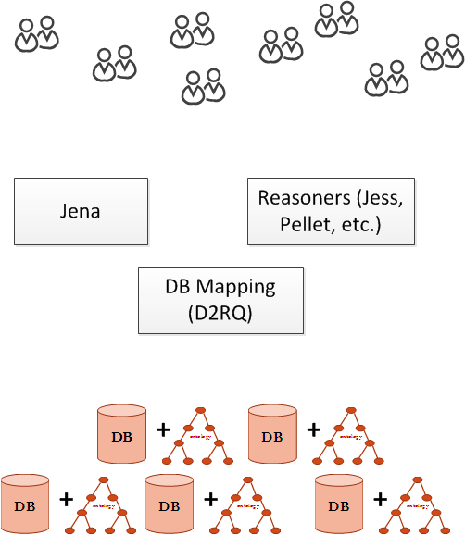
Ontology-based application development

Slide 51
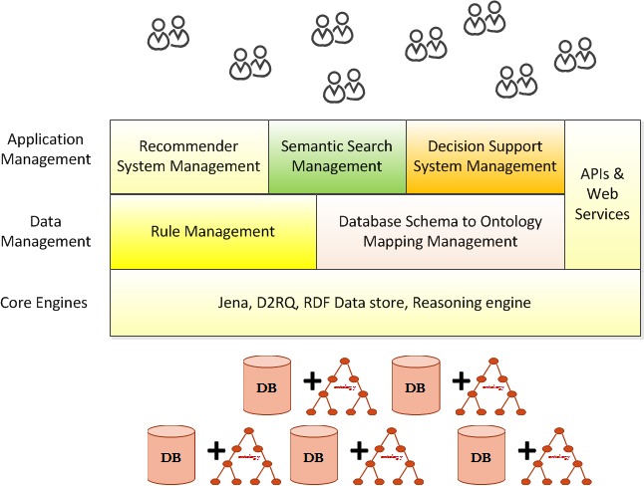






Architecture of Ontology Application Management (OAM) Framework

Slide 52
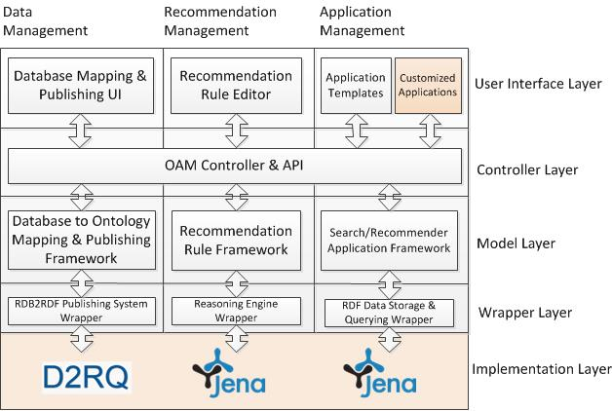
OAM Architecture

Slide 53
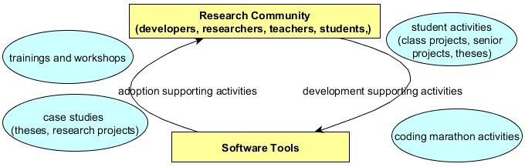
Community-driven Software Development
Buranarach, M., Thein, Y. M., and Supnithi, T., A Community-driven Approach to Development of an Ontology-based Application Management Framework, Proc. of the 2nd Joint International Semantic Technology Conference (JIST2012), LNCS, Springer, December 2012.

Slide 54
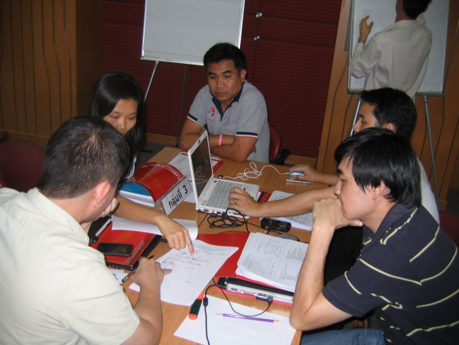
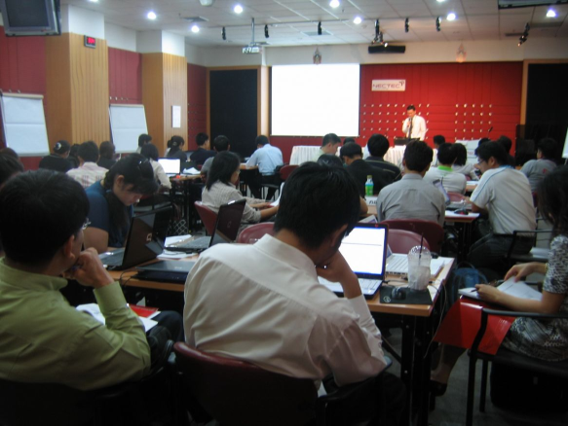
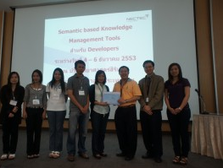
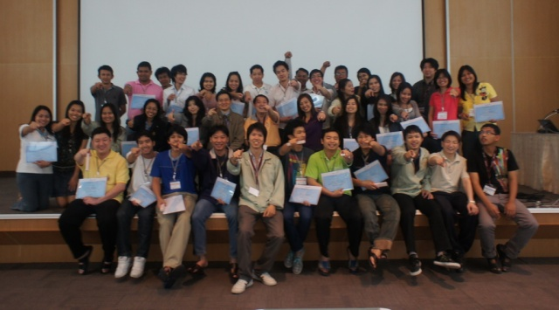
Support Activities
User trainings
Hozo
OAM
Developer’s coding marathon

Slide 55
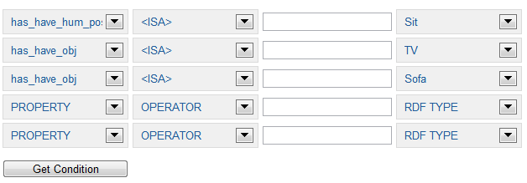
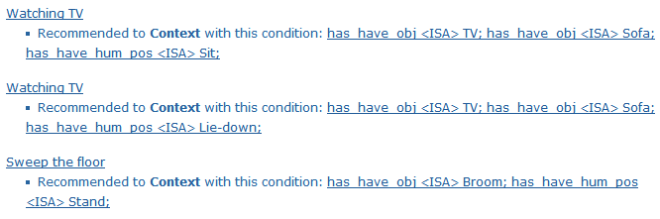

Case Study: Activity Recognition in Smart Home
Ontology-Database Mapping
Recommendation Rule Management
Semantic Search Application Template
Wongpatikaseree, K., Ikeda, M., Buranarach, M., Supnithi, T., Lim, A. O., and Tan Y., Activity Recognition using Context-Aware Infrastructure Ontology in Smart Home Domain, Proc. of the 7th International Conference on Knowledge, Information and Creativity Support Systems (KICSS2012), November 2012.

Slide 56
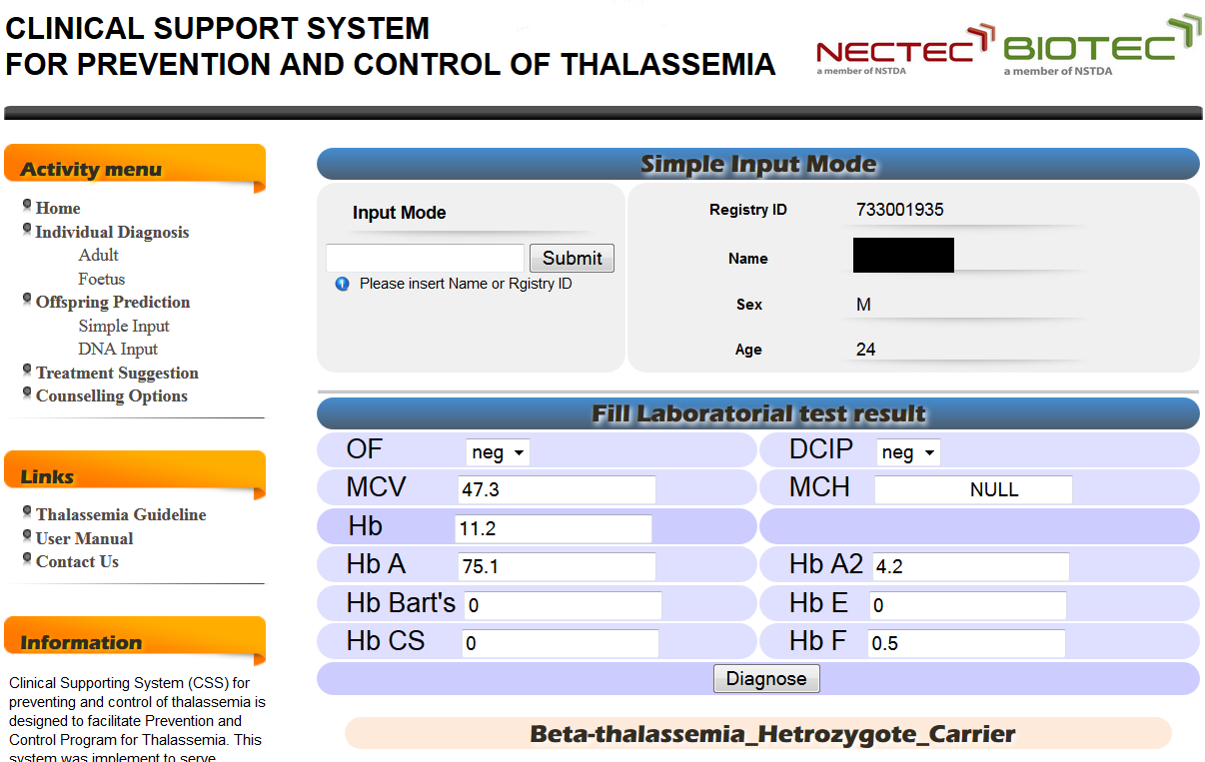


Case Study: Clinical Support System for Thallasemia

Slide 57
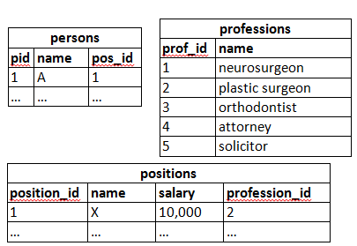
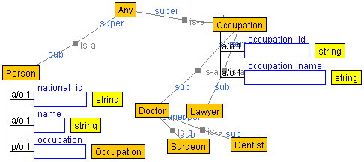
Database-to-Ontology Mapping
Database tables
Ontology for the KB

Slide 58
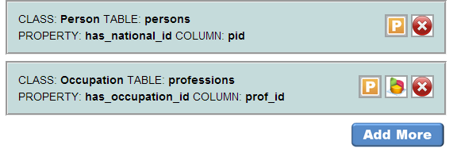
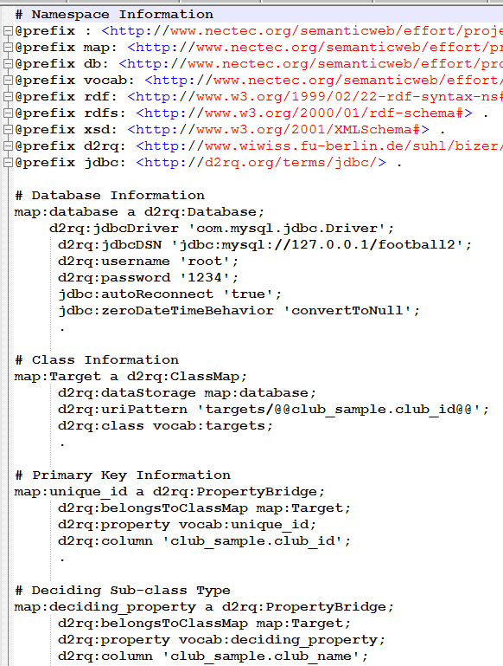
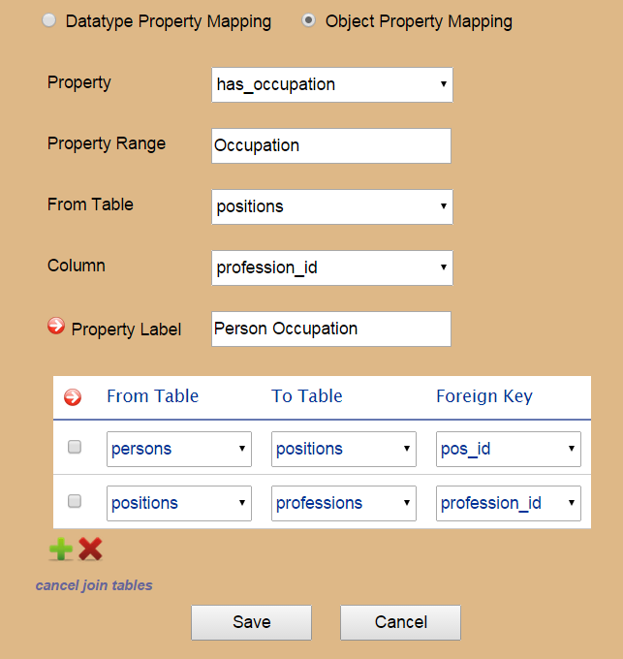
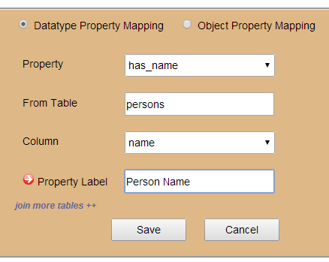
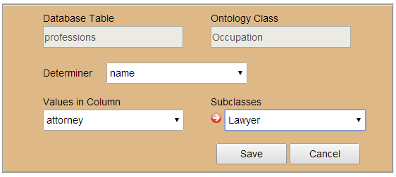
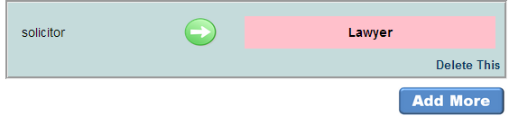
Database-to-Ontology Mapping (2)
Resulted D2RQ Mapping language
Class-table mapping
Data property to column mapping
Object property to column
mapping
Subclass mapping

Slide 59
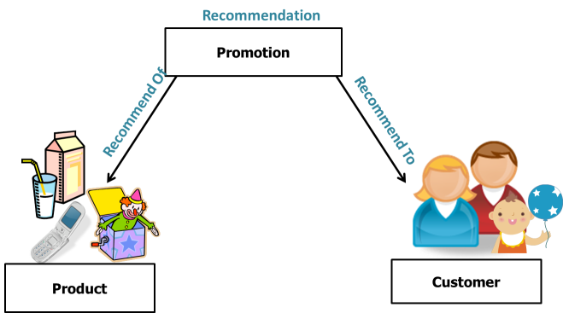


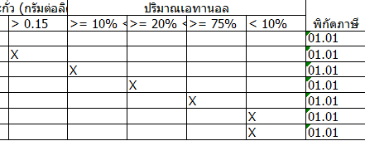
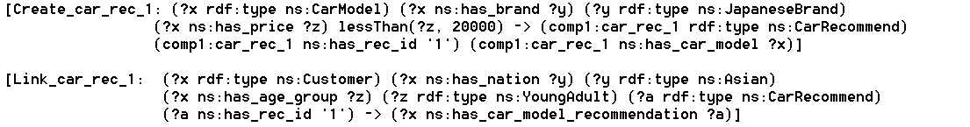
Rule Management
“Honda Jazz”
“Honda City”
“Toyota Vios”
“Nissan March”
“Suzuki Swift”
“Nobita”
“Kim”
“Somchai”
Recommendation Results
Decision table in spreadsheet
IS-A CarModel
brand IS-A JapaneseBrand price < “600000”
IS-A Customer
nation IS-A Asian and age IS-A YoungAdult
Jena’s Rule Syntax

Slide 60
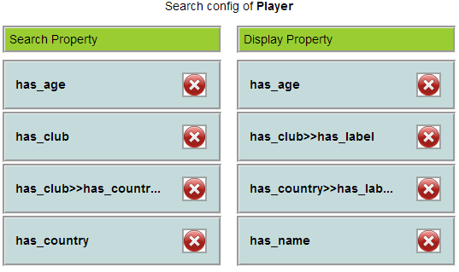
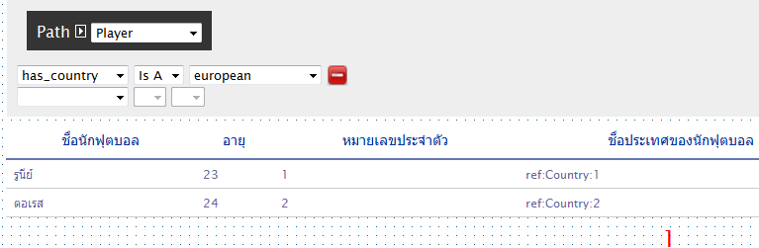
Search Application Template
application configuration
application template

Slide 61
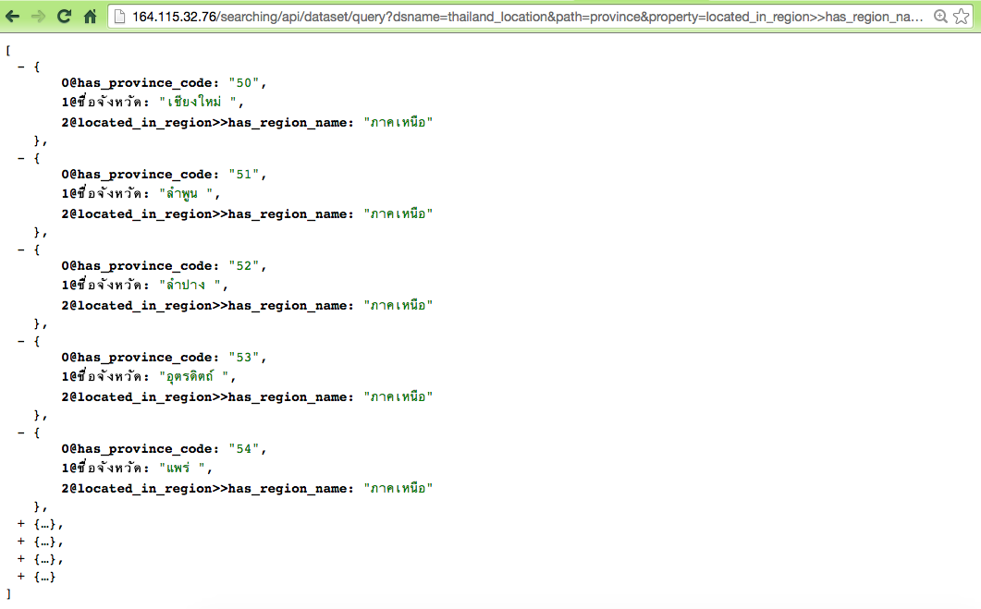
Web API for Querying
URL: http://<hostname>/searching/api/dataset/query?
path=province&property=located_in_region>>has_region_name&
operator=CONTAINS&value=aaa
URL request specifies:
Class name
Property name
Operator
Property value
JSON Results

